Slide 1


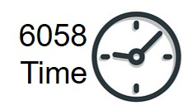






MGMT 6056 Module 4
Exercises
Do the exercise prior to next slide
Videos
Solution Slide
PPT Animations
Cost Estimation
Exercise Simulation
Printout
or
Use Excel
or
Use this Slide
M4 PRINTOUT or Digital Function Point Template.xlsx
See text in “slide note” for more details

Slide 2
Module Learning Objectives
Apply common forms of cost estimation for project work, including ROM, ballpark estimates and definitive estimates.
Understand the advantages of analogous and parametric cost estimation and the application of learning curve models in cost estimation.
Use of Function Points for estimating
Work with 3-point estimates, PERT, and Statistical Cost Estimation including probabilities
Discern the various reasons why project cost estimation is often done poorly.

Slide 3
Cost Estimation
Clearly define project’s various costs in the beginning to avoid making estimation errors.
Make your initial costs estimates accurate as possible to increase your chances of completing the project within budget.
Important to cost out project on a disaggregated basis – break it down by work package to estimate task (activity) level costs for better accuracy.

Slide 4
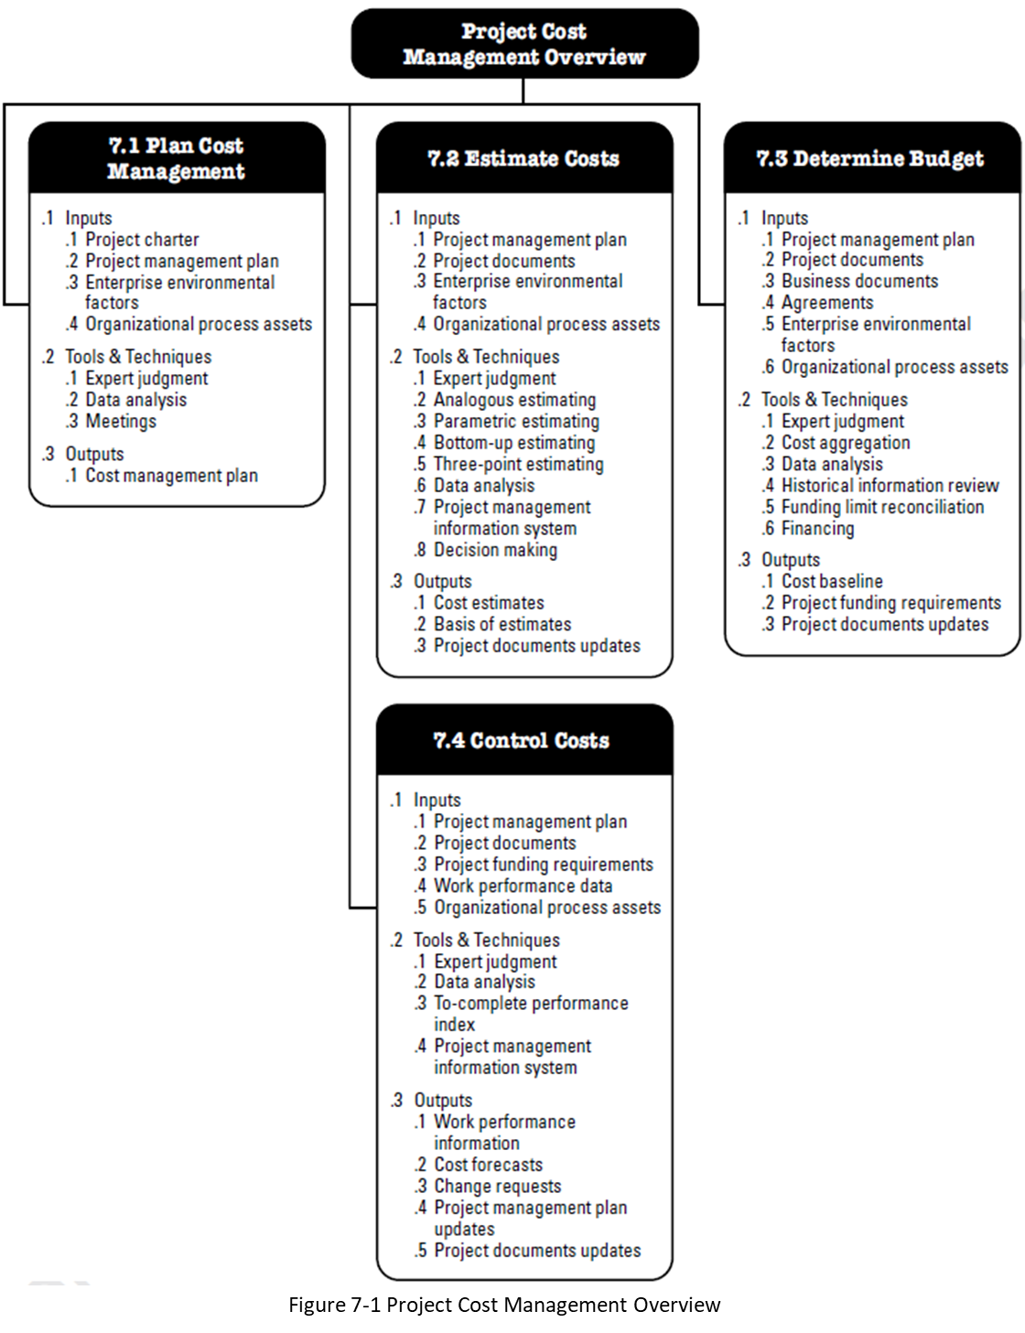
Estimate Costs 7.2 in PMBOK
A process designed to derive an approximate cost of the resources required for the project.
Once we know the type and amount of resources we can determine the amount of funds required for the project.
Source: PMBOK 6th Edition, 2017

Slide 5
Estimate Costs 7.2 in PMBOK
What is a Basis of Estimates? How we derived the estimate, i.e. the logic, data, methodology and our approach to calculations used to estimate the resources required to perform the tasks
The major outputs are the Cost Estimate, and the Basis of Estimate (logic, methodology, calculations – to perform the estimate)
Source: PMBOK 6th Edition, 2017

Slide 6
Cost Estimation (industry terms - symmetrical estimates)
Ballpark, or Rough Order of Magnitude (ROM), or SWAG ±30%
When time is scarce, e.g. to determine if worth going forward with project.
Comparative / Analogous ±15%
Based on historical data and insert multipliers to account for inflation etc.
Make sure previous work project is comparable and history is available
Parametric Estimating uses statistical relationship between relevant historical data
Feasibility ±10%
Based on real quotes after preliminary design work complete.
Definitive ±5%
Estimates upon completion of most design work.
Purchase Orders have been submitted based on known prices and specs
Example of a simple analogous estimate?
Notes:
A simple analogous/comparative estimate could be for the cost of tires for a car. Your friend spent $600 for a set of tires, and you know you want a very similar type and style of tires, but your car is a little bigger. You add 10% and your comparative estimate is 600 * 1.1 = $660.

Slide 7
Cost Estimation (but via the PMBOK Guide which are asymmetrical estimates)
Note the PMBOK 6 is using asymmetrical plus and minus numbers for two estimates, ROM and Definitive. Asymmetrical reflects the skewed nature of most estimates in projects, see slide note.
PMBOK Rough Order of Magnitude (ROM)
Range from -25% to plus 75% e.g. $1,000, becomes a range of $750 to $1,750 with $1,000 most likely
PMBOK Definitive Estimate
Range from -5% to plus 10%
Why asymmetrical?
Notes:
Asymmetrical, or a skewed distribution is more realistic. When we estimate it could be somewhat less (our O or optimistic estimate), but it could also be a lot more expensive (our P or pessimistic estimate)

Slide 8
Cost Estimation – Exercise
Two different people were asked to perform a quick estimate for a new project.
Bevin used a “comparison/analogous” approach using previous projects to come up with an estimate of $550K.
Akira provided you with a “PMBOK ROM” estimate but by mistake only gave you the lower end of the estimate, which was $420K
What are the O, M and P for each of the estimates?

Slide 9
Cost Estimation – Exercise
Bevin used a comparison approach so we’ll use the Comparative / Analogous ±15% approach:
(1-15%) * $550 = $467.5K (1+15%) * $550K = $632.5K
Range is $467.5K to $632.5K
Akira provided you with the lower end of a PMBOK ROM estimate -25%/+75%. We only need the upper end but we can get the middle estimate number first, and then find the upper end
$420K/(1-25%) = $560 $560 * (1+75%) = $980K
Range is $420K to $980K

Slide 10
Analogous Cost Estimation
Analogous (comparative) estimating means using previous costs of similar projects or activities.
For example, you are estimating the cost to build a house that is very similar to a house you built a few months ago.
You are “comparing” the new house to the old house which cost $600K. The new house looks very similar in design but has 5% more floor space, and is equipped with a few more features.
You decide on using an estimate that is 10% more than the old house, or $600K * 1.1 = $660K.
You might compare the new house to the costs of 3 or more previously built homes to arrive at your analogous estimate.

Slide 11
Parametric Cost Estimation
Parametric estimating means using variables and unit costs within the activities of your project.
For example, you are estimating the cost to build a house using construction methods and materials you are familiar with.
You know the unit costs for things like: framing floors and walls ($/ft²), unit costs to shingle the roof ($/ft²), flooring options ($/ft²), and the cost of lumber ($/ft).
You calculate the quantifies for the variables such as 1,800 square feet to be shingled, and multiple by the unit cost, say $4.80/ft² = $8,640.
The “metric” we used was was square feet

Slide 12
3-Point Estimation
Typically activity cost estimates are skewed curves, and frequently we don’t have historical data so we might have our experts estimate using 3 points - Optimistic, Most Likely, Pessimistic (O, M, P).
We use two types of 3-point estimating formulas to derive our estimate called TE.
Triangular distribution estimate, a simple average (O+M+P)/3
Beta distribution (PERT) estimate which is a weighted average, and produces a more practical estimate (closer to the median) for skewed distributions. (O+4*M+P)/6

Slide 13
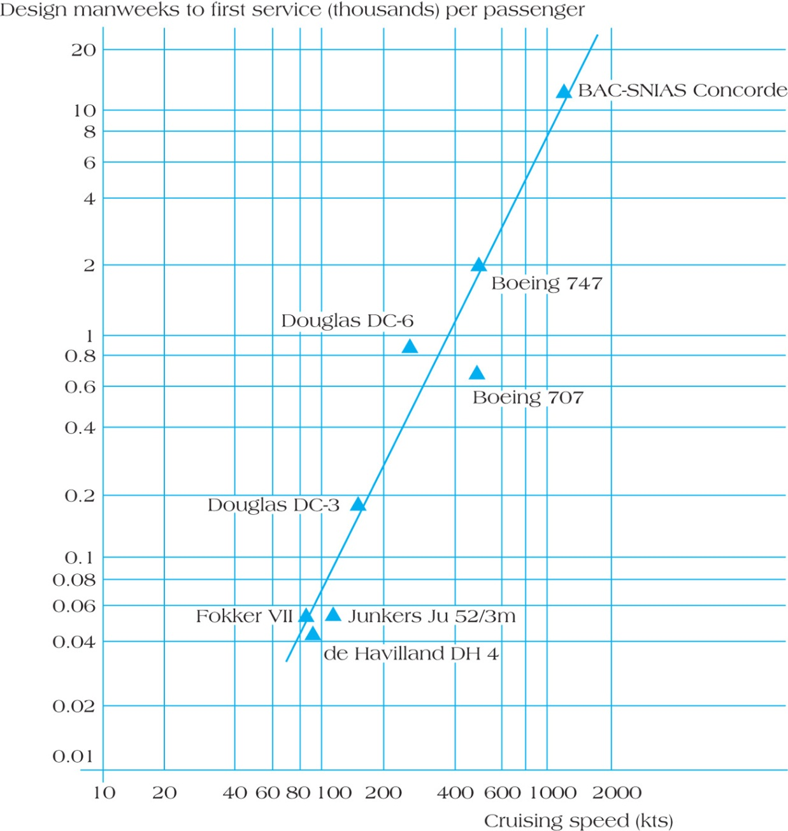


Non-linear Parametric Estimate for Design Costs for Concorde
Concorde
This is an example of a non-linear parametric estimate.
A linear parametric estimate would be about 10m of rope at $1 per metre = $10. Note the graph is a log graph on both axes.
Exercise – what would be the design cost for a 370 km/hr, 20 passenger plane if designers were $600/day? Note kts in the chart means knots.
Figure 8.2
JunkersJU 52
Notes:
Another simple linear parametric estimate could be for carpet. We have a room that is 10 square metres, our carpet is $90 per square metre, and we have a 10% waste factor (we have to buy extra carpet). 10 X $90 X 1.1 = $990.
But this exercise demonstrates that sometimes simple tools like a single chart can be used for rough estimates of items that appear to be unrelated.

Slide 14
Calculations
What are the parameters we need to use in this non-linear parametric estimation chart?
Technically we only need one parameter on the X axis to use the chart – cruising speed in kts which is actually “knots” which is sometimes used for aircraft. The conversion is 1 knot = 1.852 km/hr.
But the Y axis provides us with design person weeks in 000’s per passenger. So a second parameter is passengers.
And we also need the cost of design labour.
370 km/hr divided by 1.852 km/hr = 2oo knots.
On the chart, the Y axis number looks like it might be a bit less than 0.3, maybe 0.28, but this is a log scale so let’s estimate 0.24. So the chart provides an estimate of 0.24 person weeks (in thousands) per passenger for design, or 240 (0.24 X 1,000) weeks per passenger.
Our labour cost is $600/day and we are planning a 20-passenger aircraft.
So 240 weeks/passenger X 20 passengers X 5 days/week X $600/day = $14,400,000.
Note the use of our units, passengers cancel out, days cancel out, weeks cancel out, leaving $’s.

Slide 15
Which approach should be used for estimating?
Depends on:
Knowledge of firm’s industry
Ability to account for and manage most project costs
Firm’s history of successful project management.
Number of similar projects
Knowledge and resourcefulness of project managers
Speed with which various cost estimates must be created
Comfort level of top management has with cost estimation error

Slide 16
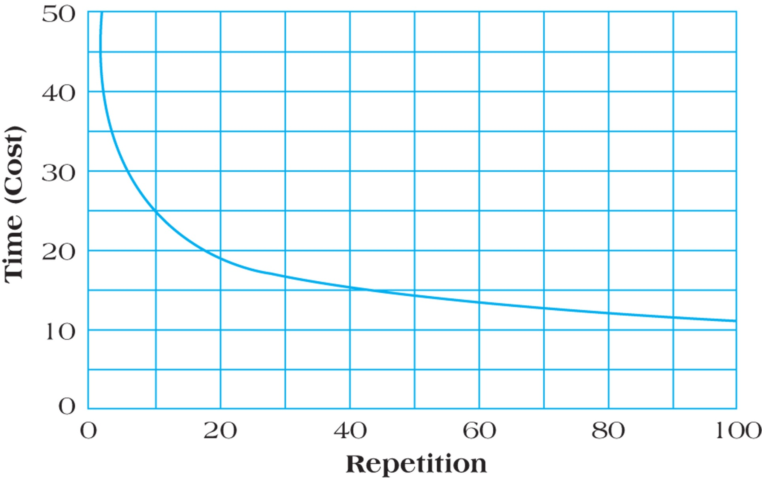
Learning Curve – a Log-Linear Model Also called a Constant Percentage Model
“If this is the first time I’ve ever done something, could I do it faster the 2nd time? The 4th time?” A doubling of my production, twice.
With repetition, the time (and cost) usually declines. Eventually it flattens out which is called “Steady State”.
Steady State
FIGURE 8.4
Notes:
“Steady State” is actually an arbitrary assumption where consider any further improvements from the learning curve to be not relevant to our analysis. So although theoretically there could further learning curve productivity improvements, we might arbitrarily consider anything beyond say, the 10th unit to be steady state. So the 11th, 12th, 20th etc. units are the same as the 10th unit.

Slide 17
Learning Curves
Repetition of activities often leads to reduction in the time necessary to complete the activity over time.
Learning curves are used for long-term contracts.
We’ll look at Learning Curves 3 different ways:
#1 The basic concept of doubling of production
#2 Use of a coefficient table including cumulative totals
#3 Use of the learning curve formula
What’s a personal example of a learning curve?
#1. A “learning %” example using 90%, this means when we double production from 1 unit to 2 units, it only takes 90% of the time to create the 2nd unit vs the 1st unit. When we double again from the 2nd to the 4th, the 4th takes 90% of the 2nd (or 81% of the 1st unit, 90% X 90%)
#1 Another example, we measured how long it took to make the 5th unit of something, and it was 80% of the 1st. So if we were estimating the time to make the 10th unit we would use 80% of the 5th unit – because we doubled production when we went from the 5th to the 10th
Notes:
If you have to assemble something you bought, and you had more than one to assemble, it would likely take you less time to assemble the 2nd one compared to the 1st one.
Commercial example it takes us 1,000 hours to create the first unit of something. What happened every time we double production? We double when go from our 1st unit to our 2nd, and double again from 2 to 4. Therefore we are applying 90% twice = 1000 X 0.9 X 0.9 = 810
1000 X .9 = 900 hours for the 2nd unit
900 X .9 = 810 for the 4th unit
And we can keep doubling.
810 X .9 = 729 for the 8th unit

Slide 18
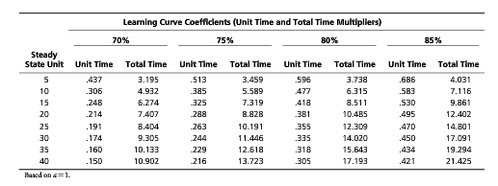
#2 Simplified Formula for Calculating Learning Curves By Using a Coefficient Table
T_{N} = T₁C
Where T_{N} = Time needed to produce the N^{th} unit
T₁ = Time needed to produce the first unit
C = Learning curve coefficient
Note, the table also provides cumulative coefficients for the first N units.

Slide 19
Understanding this table – Total Time is cumulative (summing units 1 through 5), i.e., at a learning curve of 80%, it will only take 3.738 units of time to make the first 5 units, not 5 units of time.
We can also quickly approximate the Unit Time for just the 5th unit at 80% learning curve using doubling. The 2nd unit would be .8 and the 4th unit would be .8 X .8 or .64. So the 5th unit would a little less than .64, and from the table it is, .596.

Slide 20
#2 Let’s do a question using the Learning Curve Coefficient Table
4. It took MegaTech, Inc. 100,000 labor-hours to produce the first of several oil drilling rigs for Antarctic exploration. Your company, Natural Resources, Inc. has agreed to purchase the fifth oil drilling rig from their manufacturing yard. Assume that MegaTech experiences a learning rate of 80%. At a labor rate of $35 per hour, what should you, as the purchasing agent expect to pay for the fifth unit? Remember, the simplified formula for calculating learning rate time is given as:
T_{N} = T₁C
Where T_{N} = Time needed to produce the N^{th} unit
T₁ = Time needed to produce the first unit
C = Learning curve coefficient (found on page 137)
And part 2, what would be the cost for the first 5 units?

Slide 21
Solutions to #4 MegaTech
The table lists the 5th unit learning curve coefficient as .596, assuming a learning rate of 80%. Using the formula to produce the fifth unit takes:
T_{N} = T₁C
Where T_{N} = Time needed to produce the N^{th} unit
T₁ = Time needed to produce the first unit
C = Learning curve coefficient
T₅ (5th unit) = T₁ X C
= 100,000 hours X 0.596
= 59,600 hours
To find the cost (rather than the time), multiply the hours by the hourly rate:
= 59,600 X $35 per hour = $2,086,000
For the first 5 units, at 80% we would use the coefficient 3.738 to determine the hours for the first 5 units
= 100,000 X 3.738 = 373,800 hours
To find the cost (rather than the time), multiply the hours by the hourly rate:
= 373,800 hours X $35 per hour = $13,083,000
Side note: What is the cost to make the first unit?
100,000 X 35 =$3,500,000
Use this a check against your answers.

Slide 22
#3 Learning Curve Log-Linear Model, also called a Constant Percentage Model
Each doubling of output results in a reduction in time to perform the last iteration.
The coefficient table we used is based on this formula. We can use this formula to calculate the Xth unit of output if it is not available on a coefficient table

Slide 23
#3 A question using the Learning Curve formula
Steady State implies the learning curve has flattened out and there isn’t any more reduction for addition units. But in this question, they are implying that the steady state is the 20th unit.
7. Assume you are a project cost specialist calculating the cost of a repetitive activity for your project. There are a total of 20 iterations of this activity required for the project. The project activity takes 2.5 hours at its steady state rate (which is about 20 units) and the learning rate is 75%. Calculate the initial output time for the first unit produced, using the learning curve formula:
Y_{x} = aX^{b}
Where:
Y_{x} = the time required for the x unit of output, for example the 5th unit built
a = the time required for the initial unit of output
X = the number of units to be produced, and
b = the slope of the learning curve, represented as: log decimal learning rate/log 2

Slide 24
Solutions to #7 Y_{x} = aX^{b}
We can calculate b, use the formula to first determine b, the slope of the learning curve (log decimal learning rate/ log 2):
b = log 0.75/log 2 = -.12494/0.30103 = -.415 (note the negative sign)
We know X = the number of units to be produced, X = 20
We know Y_{x} = the time required for the x^{th} unit of output, in this case the 20th unit Y = 2.5 hours
So we can plug these numbers into our formula Y_{x} = aX^{b}
2.5 hrs. = a x (20) ^{–0.415} We calculate (20) ^{–0.415} first based on order of operation https://www.mathsisfun.com/operation-order-pemdas.html
2.5 hrs = a x 0.28845 2.5/0.28845 = a
Solve for a, a = 8.667 hours
How do we get a negative sign for the -0.415 into the formula on our calculator?
Notes:
Calculators vary on how you would enter a negative number into an exponent, make sure you know how to do this with your calculator. You can test this by entering 2^4 into your calculator to get 16 but if we use -4, we would have 2^(-4) = 1/(2^4) = 1/(2*2*2*2) = 1/16 = 0.0625.

Slide 25
Software Project Estimation – Function Points
Software projects are known for overshooting their schedule and cost estimates by serious amounts.
Function Point Analysis is a system for estimating the size of software projects based on what the software does.
Function points are a standard unit of measure that represents the functional size of a software application.

Slide 26
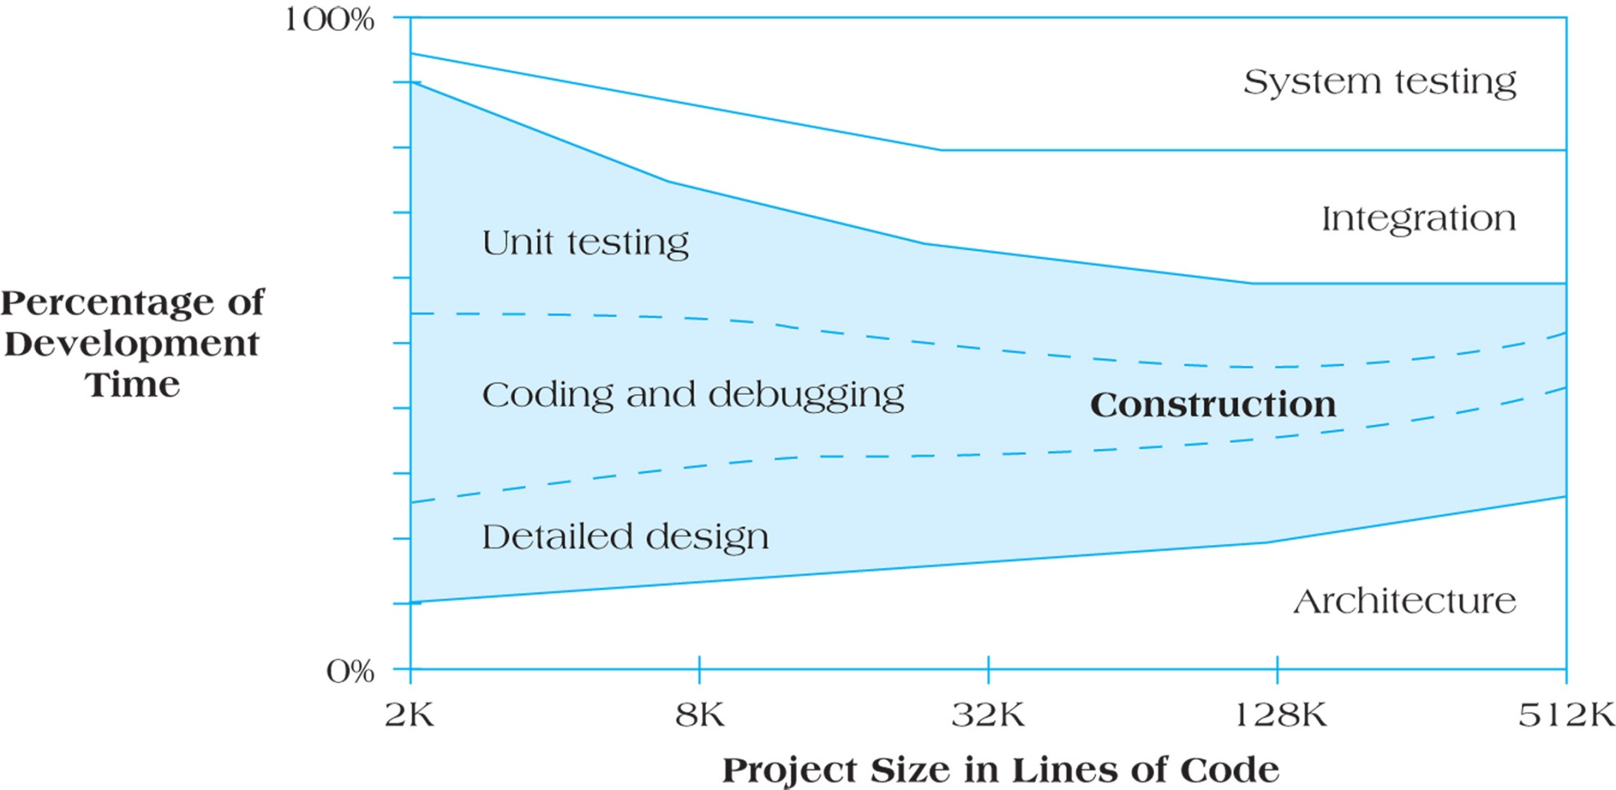
Software Project Development Activities as a Function of Size
The bigger the project, the higher the percentage of time spent outside of coding (construction of code)
Figure 8.5
So what does this chart mean?
Notes:
We use function points primarily as a vehicle to estimate software programming (construction in the chart). It is not as valuable to use for activities outside of programming, such as system testing, integration and architecture.

Slide 27
Restaurant Problem Using Function Points
From past experience:
One programmer working for one month (a ‘person-month”) can generate an average of 10 function points.
Average system technical and environmental complexity weightings found on following table
For the project based on interviews with restaurant owners complexity for inputs (medium), outputs (high), interfaces (low), queries (medium), and files (low)
We know the clients require the following number of each function: input screens ( 15), output screens (20), interfaces (3), queries (6) and report files (40)
Average cost per programmer is $60,000/year
What is the cost for completing the job?

Slide 28
Function Point Exercise.
 | Complexity Weighting
Function | Low |  | Medium |  | High |  | Total
Number of Inputs | 2 x _____ = |  | 4 x ___ = |  | 6 x _____ =
Number of Outputs | 4 x _____ = |  | 6 x _____ = |  | 10 x ______ =
Number of Interfaces | 3 x ___ = |  | 7 x _____ = |  | 12 x _____ =
Number of Queries | 5 x _____ = |  | 10 x ___ = |  | 15 x _____ =
Number of Files | 2 x ___ = |  | 4 x _____ = |  | 8 x _____ =
Total
What is the cost for completing the job?
M4 PRINTOUT or Digital Function Point Template.xlsx
Printout
or
Use Excel
or
Use this Slide

Slide 29
Function Point Calculations for Restaurant Reorder System

Slide 30
Answer
Preferred approach, figure out the cost per function point first, which makes it quicker to estimate costs across many different projects and is standard practice
409 Function Points
A programmer ($60K/year) costs $5,000 per month and can generate 10 function points per month, so that’s $500 per function point
409 function points at $500 per point is $204,500 estimate
Alternative approach – Some students use the number of function points per month, and a labour cost per month
409 Function Points / 10 Functions Points per month = 40.9 person months to complete project
40.9 person months * $60,000/12 (cost per month) =
$204,500 cost estimate to complete the project
Notes:
The preferred approach is to figure out the cost per function point, $/point, and this number is reused with other projects. This is similar to created a fully loaded labour rate, and then using it with other projects.

Slide 31
Function Point Exercise.
You work at a regional health care center and have been asked to calculate the expected cost for a software project in your organization. You know that historically, your programmers can handle 20 function points each person-month and that the cost per contract programmer in your company is $300 per work day. Contractors are not paid for statutory holidays (there are 11 this year) nor for the time they don’t work so they can have a 3-week vacation.
08-22 Functions | # of Screens | Complexity |  | # of Screens | Complexity
Input | 8 | Low |  | 4 | Medium
Output | 6 | Low
Interfaces | 15 | High
Queries | 5 | High |  | 4 | Medium
Files | 25 | Medium
Further, you know that the complexity weighting for these functions follows a standard internal formula, shown as the table on the next slide.

Slide 32
Function Point Exercise.
 | Complexity Weighting
Function | Low |  | Medium |  | High |  | Total
Number of Inputs | 2 x _____ = |  | 4 x _____ = |  | 6 x _____ =
Number of Outputs | 3 x _____ = |  | 6 x _____ = |  | 12 x _____ =
Number of Interfaces | 6 x _____ = |  | 12 x _____ = |  | 18 x _____ =
Number of Queries | 4 x _____ = |  | 6 x _____ = |  | 8 x _____ =
Number of Files | 2 x _____ = |  | 4 x _____ = |  | 8 x _____ =
Total
A Calculate the total estimated number of function points for this project.
B What is the cost for a contractor to perform a function point?
C Calculate the total expected cost of the project.
M4 PRINTOUT or Digital Function Point Template.xlsx
Printout
or
Use Excel
or
Use this Slide

Slide 33
Solution: A - Because we know the estimated complexity for each of the software functions that must be coded and the number of screens for each function, the calculation is relatively straightforward: Multiplying, we find that the total function points for this project are estimated to be 484.
 | Complexity Weighting
Function | Low | Medium | High | Total
Number of Inputs | 2 x __8 _ = | 4 x __4 _ = |  | 32
Number of Outputs | 3 x __6__ = |  |  | 18
Number of Interfaces |  |  | 18 x _15__ = | 270
Number of Queries |  | 6 x __4 _ = | 8 x __5__ = | 64
Number of Files |  | 4 x _25__ = |  | 100
 |  |  | Total: | 484
B - What is the cost for a contractor to perform a function point?
Solution: Each Contractor can complete 20 function points per month or 240 per year. Contractors work 52 X 5 days = 260, less 11 statutory holidays, less15 work days for their 3 week vacation which equals 234 days. Paid $300 per day X 234 days is $70,200. $70,200 per year divided by 240 function points per year = $292.50 per function point.
C - Calculate the total expected cost of the project.
$292.50 per function point X 484 function point = $141,570.

Slide 34
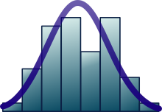
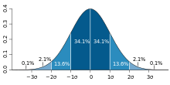
Duration or Cost, using
Basic Statistics
Mean
Standard Deviation, SD, or (Sigma σ) or s
Variance (the square of standard deviation)
Project Variance (and Project Sigma)
Probability distribution and Z (number of standard deviations)
Retrieved from https://en.wikipedia.org/wiki/Normal_distribution
68–95–99.7 rule for 1, 2, and 3 sigma’s

Slide 35
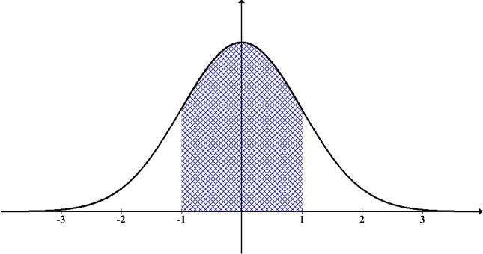
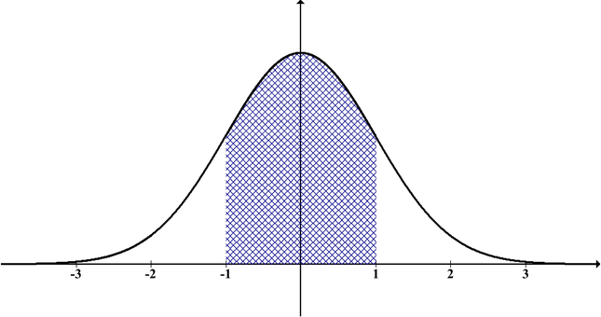
Variance & Standard Deviation
Variance and particularly Standard Deviation are a measure of the width of a normal distribution curve. Variance is the square of Standard Deviation.
Rough Order of Magnitude (ROM) estimates, which could be called Ballpark or SWAG estimates, would have a larger standard deviation than a more precise definitive estimate

Slide 36
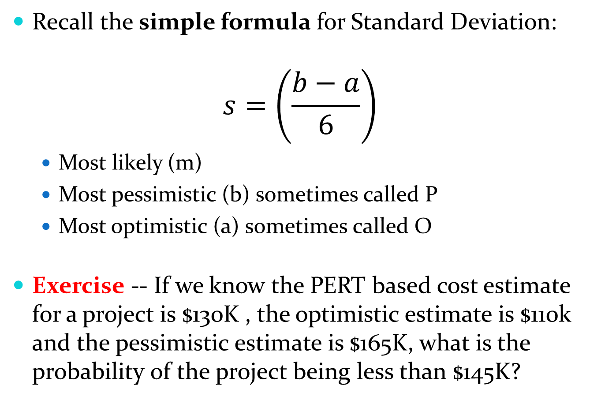
Probability of Project Meeting Cost Estimate
Recall the simple formula for Standard Deviation:
$$s=\left(\frac{b−a}{6}\right)$$
Most likely (m)
Most pessimistic (b) sometimes called P
Most optimistic (a) sometimes called O
Exercise -- If we know the PERT based cost estimate for a project is $130K , the optimistic estimate is $110k and the pessimistic estimate is $165K, what is the probability of the project being less than $145K?
We’ll use this approach when we don’t have a sample set of data, e.g. we’ve never done this activity before but our experts came up with an O and P estimate!
Notes:
Frequently we don’t have historical data for projects, or activities within projects. So we can’t use the traditional standard deviation calculated from a data set. But we might have experts who can estimate an extremely high and low estimate, our pessimistic P (also called “b” in this slide) and our optimistic O (also called “a” in this slide).

Slide 37
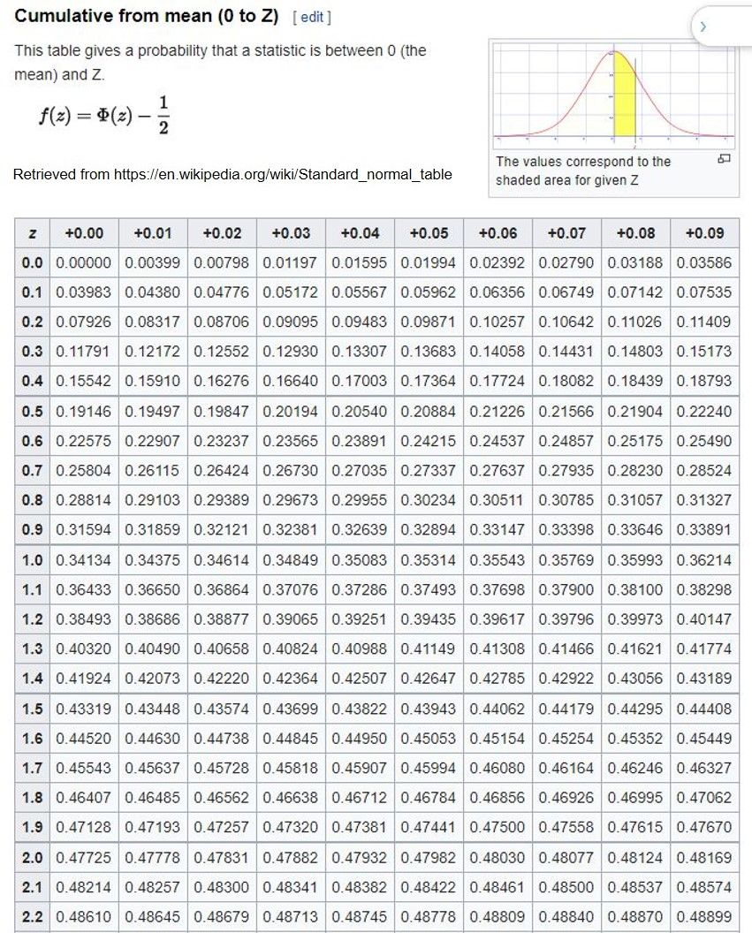
Probability Distribution
We can use this Z table to determine the probability of a scenario cost for a project, but we need to know:
Estimated project cost
Project standard deviation
What is the cost estimate mentioned in the scenario?
Determine Z, via a calculation
And then we can use the Z table to determine the probability
Note the key above, for the Z Table, the yellow area in the table
Z = the number of standard deviations we’re using

Slide 38
Probability Distribution
Note the key for the Z Table
What is the answer to our scenario?

Slide 39
Probability of Project Cost (cont’d) What is our Project Std Deviation and Z?
Project Standard Deviation (σ) or s = (p - 0)/6 = (165 -110)/6 = 9.166
We are interested in the Z for the cost of $145K. Z is the number of standard deviations from the top of our normal distribution curve (our project cost estimate of $130K). 145 - 130 =15 Z = 15/9.166 = 1.64, or in other words, 145 is 1.64 standard deviations away from 130.

Slide 40
Probability of Project Cost (cont’d) What is the probability of Z in our table? And what is the probability for our question?
Looking at Appendix A with a Z of 1.64, we get a probability of 0.4495 which means there is 44.95% probability of the project being between $130K and $145K.
But we really want to know the probability of the project being anywhere less than $145K (between $0 and $145K) so we add 50%, to make 94.95% probability. The 50% represents the left hand side of the bell curve, or the probability of the project being between $0 and $130K.
New question, we want to know what the project cost would be so we had a 33% chance of our project being this cost or less -- to secure a bonus?

Slide 41
New question, our estimated project cost is $130K and using a normal distribution curve, we assume there is a 50% chance the cost will be more and a 50% chance the cost would be less. New question, what would the cost have to be such that we only had a 33% chance of it being cheaper?
We would have to use a Negative Z with the table we have which is a challenge so we are going to use an online tool (below) as well as the table.
M4 Math is Fun, Standard Normal Distribution Table
https://www.mathsisfun.com/data/standard-normal-distribution-table.html
Using this tool, select “Up to Z” in the top left, and use your cursor and left and right arrow keys to show “33%” probability and note what Z is.
Use Z to figure out the cost.

Slide 42
We had a probability in mind of 33%, and want to know the project cost.
M4 Math is Fun, Standard Normal Distribution Table
https://www.mathsisfun.com/data/standard-normal-distribution-table.html
With the online tool above, use the radio button setting “Up to Z” and when you slide Z to be 33%, Z = -.44.
Because Z represents the number of standard deviations (s), we multiple our “s” by Z, 9.166 X -.44 = -4.03
So $130K - $4.03 ≈ $126K Note we subtracted.
If our bonus number was set at $126K, we would have a 33% probability of achieving our bonus -- having our project cost $126K or less, or between $0K and $126K
We could also use the table, but it’s much trickier.

Slide 43
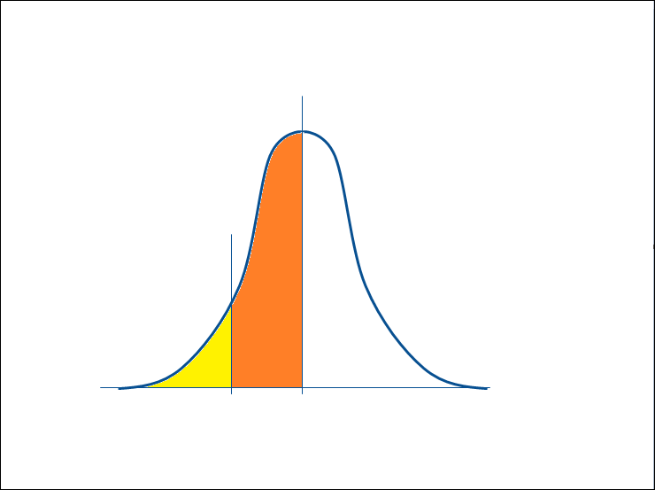
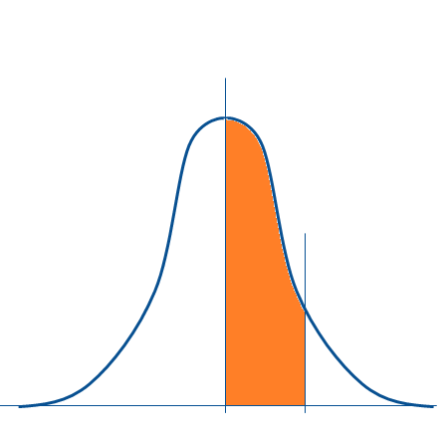
But could we look up the answer for Z, using our Probability Distribution Table?
2) The area of the left side of the curve is 50%, so this area has to be 17% (50%-33%)
3) If we flip the area from the left side to the right, we can use our table. This area would still be 17%
1) This area is given to us, it has to be 33%
Follow steps 1 through 4
4) If we look up 17% on our table (the closet number is 0.17003), we also get a Z of 0.44, but it’s really - 0.44, so we use accordingly.

Slide 44
We determined Z, what but what would be the cost of the project?
The area of the left side of the curve is 50%, so this area has to be 17% (50%-33%)
This area is given to us, it has to be 33%
$126K
$130K
$130K - $4.033K
≈ $126K
- 0.44 Z = -.44 * $9.166K = -$4.033K
There is a 33% probability of our project costing less than $126K

Slide 45
Problems with Cost Estimation
Low initial estimates
Unexpected technical difficulties
Lack of definition
Specification changes
External factors
Any many more …
What problems have you personally faced when you’ve tried to estimate costs?

Slide 46
Review of Learning Objectives
Apply common forms of cost estimation for project work, including ROM, ballpark estimates and definitive estimates.
Understand the advantages of analogous and parametric cost estimation and the application of learning curve models in cost estimation.
Use of Function Points for estimating
Work with 3-point estimates, PERT, and Statistical Cost Estimation including probabilities
Discern the various reasons why project cost estimation is often done poorly.

Slide 47
Homework
Refer to the Start Here section of this module
Read for next module:
Kerzner 12th Ed 506-509, 529-531, 11th 745-747, 773-775
PMBOK 6th Ed 7.3
Review PPT files with solutions
Assignments, practice quizzes and graded quizzes, check the Course at a Glance and FOL/Content/Course Assignments & FOL/Evaluations/Quizzes

Slide 48


